Slide 1

http://www.niso.org/news/events/2013/webinars/copyright
NISO Webinar: Research Data Curation Part 1: E-Science Librarianship
September 11, 2013
Speakers:
Elaine Martin - Editor, Journal of eScience Librarianship,
University of Massachusetts Medical School
Chris Shaffer, MS, AHIP - University Librarian and Associate Professor,
Oregon Health & Science University Library
Megan Sapp Nelson - Associate Professor of Library Sciences,
Purdue University

Slide 2
Preparing Librarians for New Roles in E-Science
Elaine R. Martin, DA
Director of Library Services
University of Massachusetts Medical School
September 11, 2013

Slide 3
Highlights
Librarian Needs Assessment and Findings
Researcher and Student Interviews and Findings
NER Program Descriptions and Strategy
Challenges
Lessons Learned
Projects in Progress
Future Planned Educational Opportunities

Slide 4
e-Science Role Definition Questions
What roles can librarians play in helping researchers and students manage and preserve data?
What knowledge and skills do practicing librarians need?
What are the new competencies for librarians in e-Science roles?
How can we create a community of e-Science librarians in the New England Region (NER)?
How can we teach RDM?
How can NER help?

Slide 5
NER Librarian Needs Assessments
Brainstorming session at regional e-Science symposium in April 2009
Follow-up survey regional needs assessment conducted summer 2009
Published JMLA 2010
Competencies survey (2011)
Published JeSLIB (2012)

Slide 6
Librarian Findings: Education and Collaboration
Online tutorials for both e-Science related tools and background/content knowledge for librarians
Continuing education (science disciplines as well as with respect to data management) for librarians
Support from the library community (University of Massachusetts, Boston Library Consortium, and NN/LM, NER) for librarian sharing of role definition
Source: JMLA 99(2):153-56, Apr 2011

Slide 7
Librarian Findings: Competencies
Librarians saw their future roles involving RDM and sought competencies in conducting data interviews with patrons and helping patrons with NSF data management requirements. The survey results indicate the greatest need for librarians is technical hands-on training in the digital description and curation of large data sets.
Source: JeSLIB http://dx.doi.org/10.7191/jeslib.2012.1006

Slide 8
Researchers and Students Assessment: Data Interviews
How are data in the lab or research environment used?
How do researchers manage, preserve, and store data?
How easy would it be to share the data with another researcher who needed or wanted access (e.g. data sharing plan)?
What is the role for the library? IT? Other groups on campus?
How are students taught RDM?
Source: IMLS grant, 2010-11

Slide 9
Student and Researcher Findings
Data were scattered and poorly managed
Curriculum needed to teach data management to researchers and their students
They needed assistance with NSF data management plans

Slide 10
Regional Program Response
Initiatives fostering health sciences and science librarians collaboration:
e-Science Symposium
Science Boot Camp focused on building science discipline knowledge
One day Professional Development workshops on discipline or research data management topics (stem cells; nanotechnology; metadata; informationist; how to teach RDM)

Slide 11
Regional Program Response Continued…
NER Portal Project
e-Science Librarian Community of Interest (COI)
RDM curriculum and teaching cases
Dissemination strategies:
e-Science Community Blog
online journal JeSLIB

Slide 12
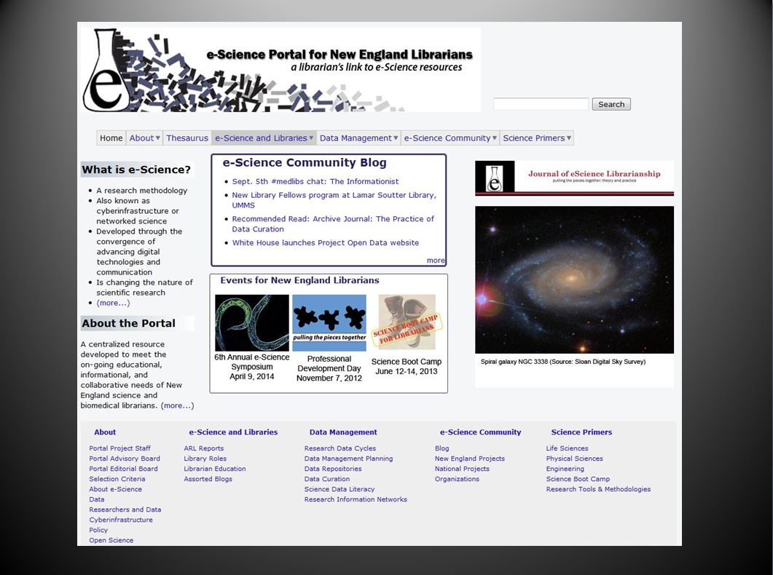
e-Science Web Portal Project esciencelibrary.umassmed.edu
Regional Initiative with UMMS in the lead
A one-stop shopping website for librarians to learn about science and data management

Slide 13
e-Science Web Portal Project esciencelibrary.umassmed.edu
Include current news and initiatives
Highlight current projects and best practices
Create collaborative using advisory and editorial boards to identify, link to existing and create original content
Engage the librarians in New England via the e-Science Community Blog to foster a community of learning

Slide 14
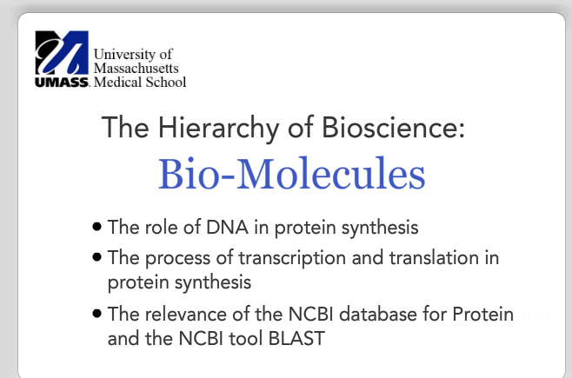
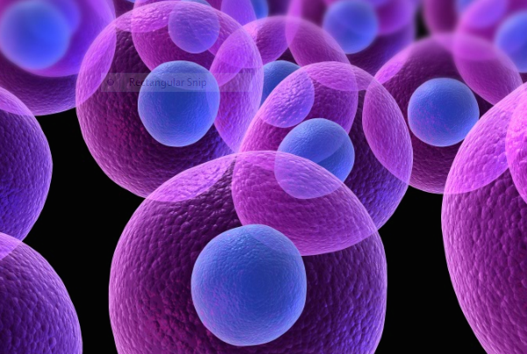
e-Science Web Portal Project esciencelibrary.umassmed.edu
Educate Librarians about Science (tutorials)
http://esciencelibrary.umassmed.edu/biochemistry-video

Slide 15
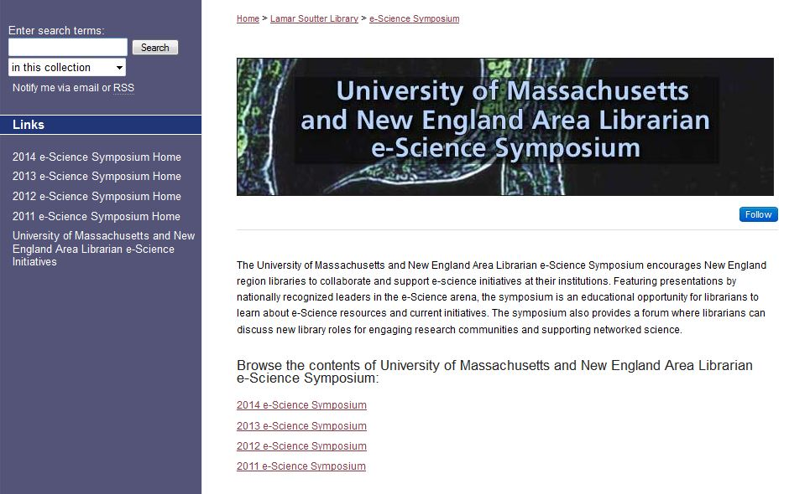
April 9, 2014 e-Science Symposium

Slide 16
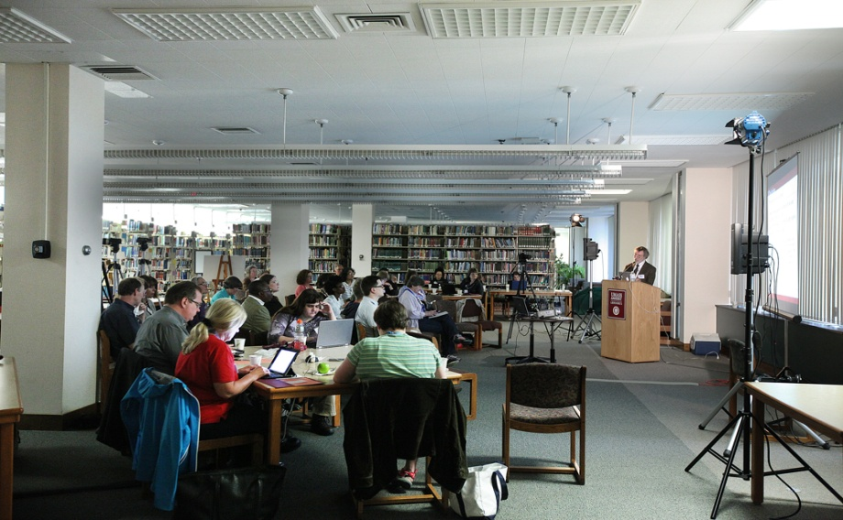
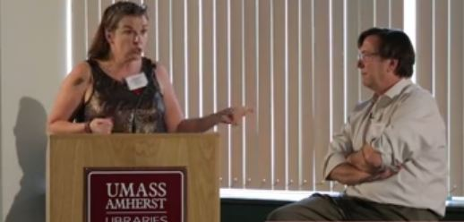
Science Boot Camp
Science Boot Camp: June 2013 at UMass Amherst

Slide 17
Sampling of e-Science Professional Days
Introduction to Metadata (May 9, 2012)
Examples of uses of metadata by local area librarians
Keynote speaker Diane Hillmann
Role of the library in the research enterprise, Informationists (Nov. 2012)
Keynote speaker Chris Schaffer, University Librarian Oregon Health and Science University Library
Panelists: Librarian Informationists working on research team on NIH grants

Slide 18
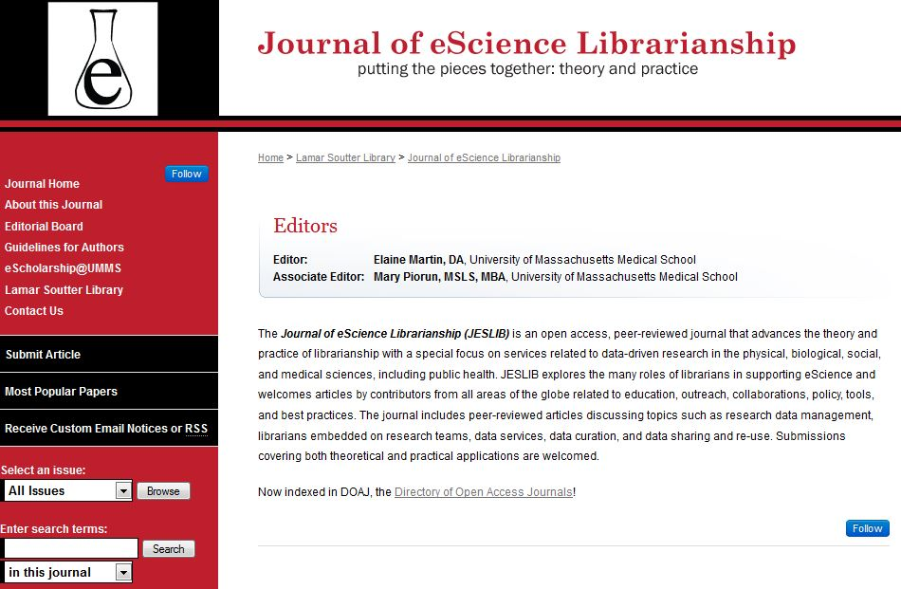
Journal of eScience Librarianship

Slide 19
Journal of e-Science Librarianship
Special issues
e-Science Symposium papers and posters
Informationist issue
Open call for papers
Editors are UMMS librarians
Outside advisory board
Reviewers are members of e-Science COI
Experimenting with formats and publishing schedules

Slide 20
Data Management Curriculum Development
2010-2011 IMLS grant to bring data management skills to student researchers (UMMS and WPI); develop learning objectives and lesson plans for data management curriculum
Identify data repository requirements for student projects (student data repository)
Develop tutorials for web-based case-based data management curriculum

Slide 21
Data Management Curriculum Development
2012-2013 UMMS awarded NN/LM NER grant to develop the frameworks into a course with module content, lecture slides, activities, and teaching cases.
Partners: UMass Amherst, Marine Biological Laboratory and Woods Hole Oceanographic Institute Library, Northeastern University, and Tufts University
Designed for flexibility

Slide 22
Data Management Course
Module 1: Overview of Research Data Management
Module 2: Types, Formats, and Stages of Data
Module 3: Contextual Details Needed to Make Data Meaningful
Module 4: Data Storage, Backup, and Security
Module 5: Legal and Ethical Considerations for Research Data
Module 6: Data Sharing & Re-Use Policies
Module 7: Plan for Archiving and Preservation of Data
http://library.umassmed.edu/data_management_frameworks.pdf

Slide 23
Case-Based Learning
Cases provide the opportunity for instructors and students to explore discipline-specific data management issues
Course modules provide a context of universal data management issues and best practices

Slide 24
Implementing the Curriculum
Webinar 10/31 on Module 1: Overview of Research Data Management and writing data management plans
On-site Professional Development Day 11/8: Regional Data Management Education Course: How to Teach RDM Using the New England Collaborative Data Management Curriculum

Slide 25
Educating Next Gen-Librarians
Partnered with Simmons College Graduate School of Library and Information Sciences
15-week course covering librarian roles in research data management
Students conduct data interviews with researchers, develop teaching cases, and write data management plans

Slide 26
532G-01 Scientific Data Management
Students learn from researchers’ cases
Scientists share workflows and their data management practices, challenges
Data Management Plans (DMPs)
Data repositories, Open Science, Open Data
Annotating data sets
Preserving and archiving data
Developing library data services and data policies
Research Informationists

Slide 27
Challenges for e-Science Librarians
Debate: How much science do librarians working with researchers need to know?
For NER-How do you manage the collaboration?
How do you teach data management? How do you engage the research community? Faculty? Students? Clinical Researchers?
NSF Data Management Plan—impact on grant funding? What kind of assistance can the library provide?
Models for embedded librarians in a research team

Slide 28
Lessons Learned
We need to partner (with science majors, science librarians, main campus computing centers, library schools, health science librarians, researchers, IT, etc.)
We need to re-tool our staff with new skills in science (basic science knowledge and research process)
We need to develop staff with skills in data management, preservation, metadata, etc.
We need new kinds of staff – new job descriptions
NN/LM, NER can create venues for collaboration and education and help disseminate information on new roles

Slide 29
NER Projects (In –Progress)
What are the educational programs available to train e-Science librarians? Where are the gaps? Where can NER fill those gaps?
What is the vocabulary for e-Science librarianship? What are the knowledge domains? (Thesaurus Project)
Can we define e-Science Librarianship as an academic discipline?
How will data management instruction take place? What are the best practices in teaching RDM?

Slide 30
Upcoming Regional Activities and Events
Seek regional partners for implementation of data management curriculum
Fall 2013 Scientific RDM class at Simmons GSLIS
Assist NER Network members in creating a new professional identity focused on data management and preservation via educational offerings
Oct. 31, 2013: Overview of RDM webinar
Nov. 8, 2013: How to Teach RDM Class for librarians
April 9, 2014: e-Science Symposium
June 2014: Science Boot Camp TBD

Slide 31
New England e-Science Program
e-Science COI
(180+ librarians)
Funders
NN/LM NER
IMLS
BLC
NAHSL
SBC sponsors
Advisory Group
e-Science Librarianship
1 professional development day
Prof. Development Education Prof. Development Day
e-Science symposium
Science Boot Camp
Simmons GSLIS
Course: How You Teach RDM
Tools/Resources
e-Science portal
content for RDM class
e-Science Thesaurus
Dissemination
Journal of eScience Librarianship
e-Science Community Blog
Twitter feeds
Research Agenda
Gaps?
Collaborate with Simmons

Slide 32
Questions?
Contact: Elaine Martin, DA
Elaine.martin@umassmed.edu
Director, Lamar Soutter Library
National Network of Libraries of Medicine, New England Region
University of Massachusetts Medical School
Worcester, MA

Slide 33
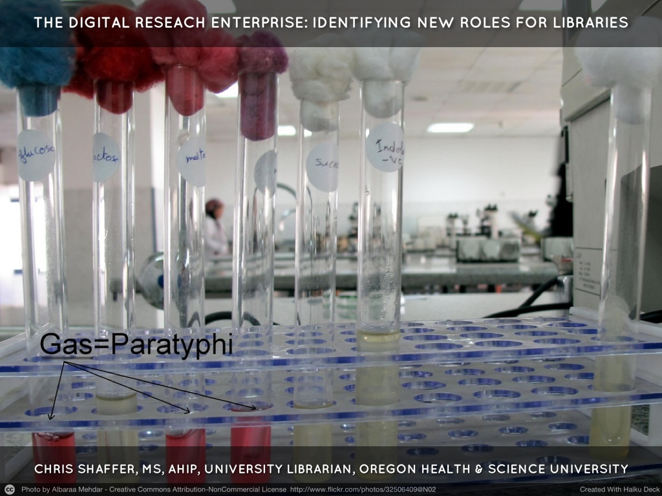

Slide 34
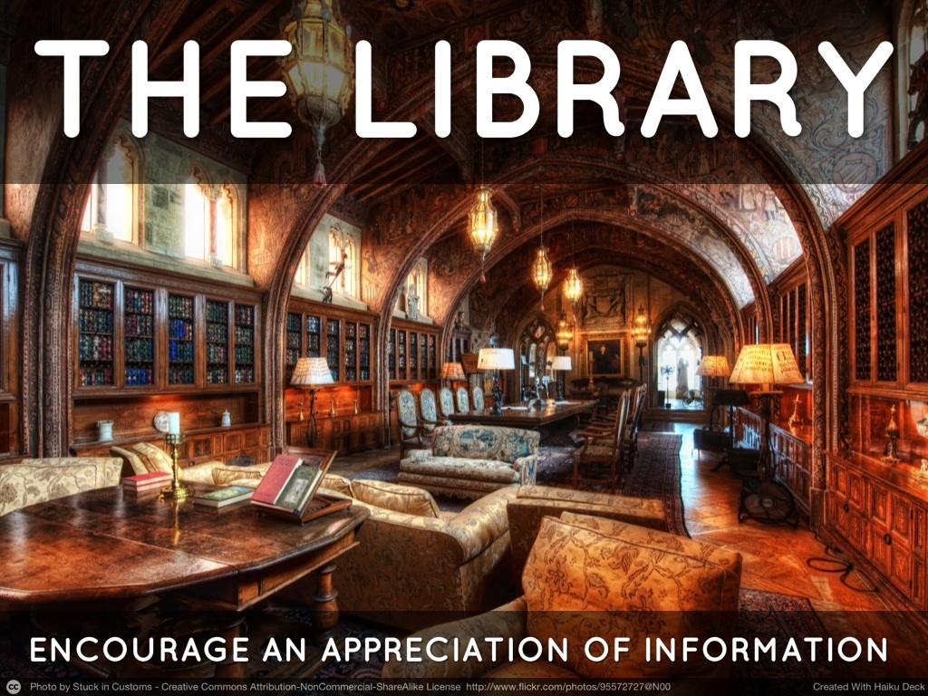

Slide 35
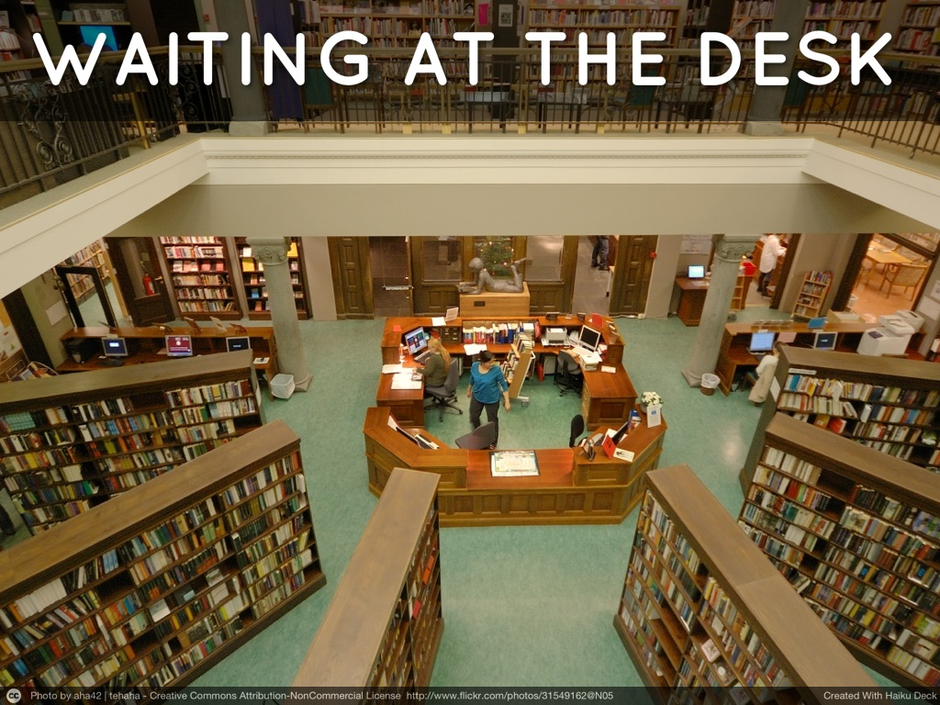

Slide 36
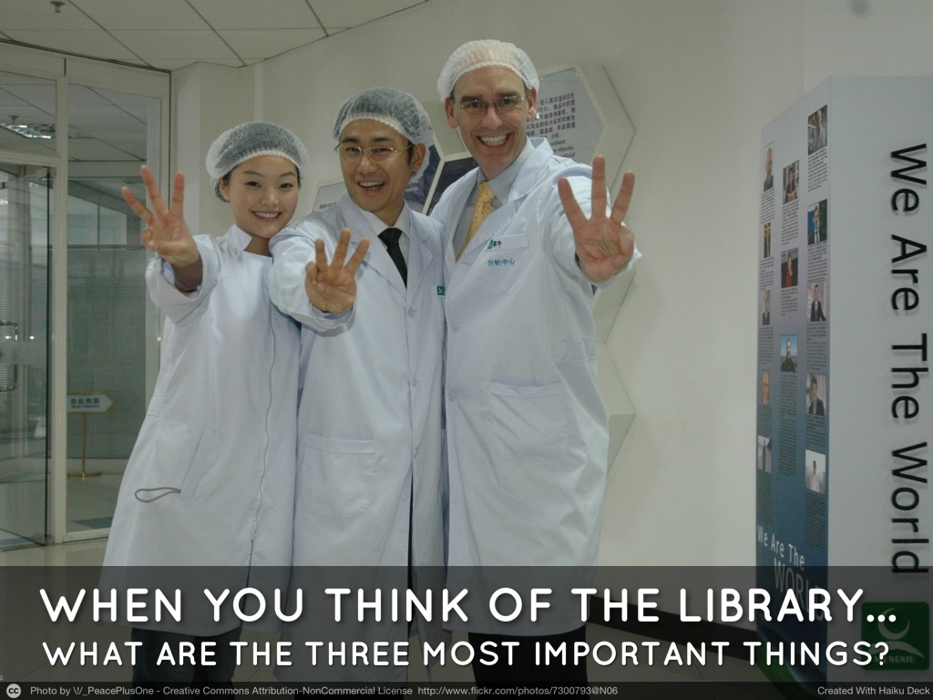

Slide 37
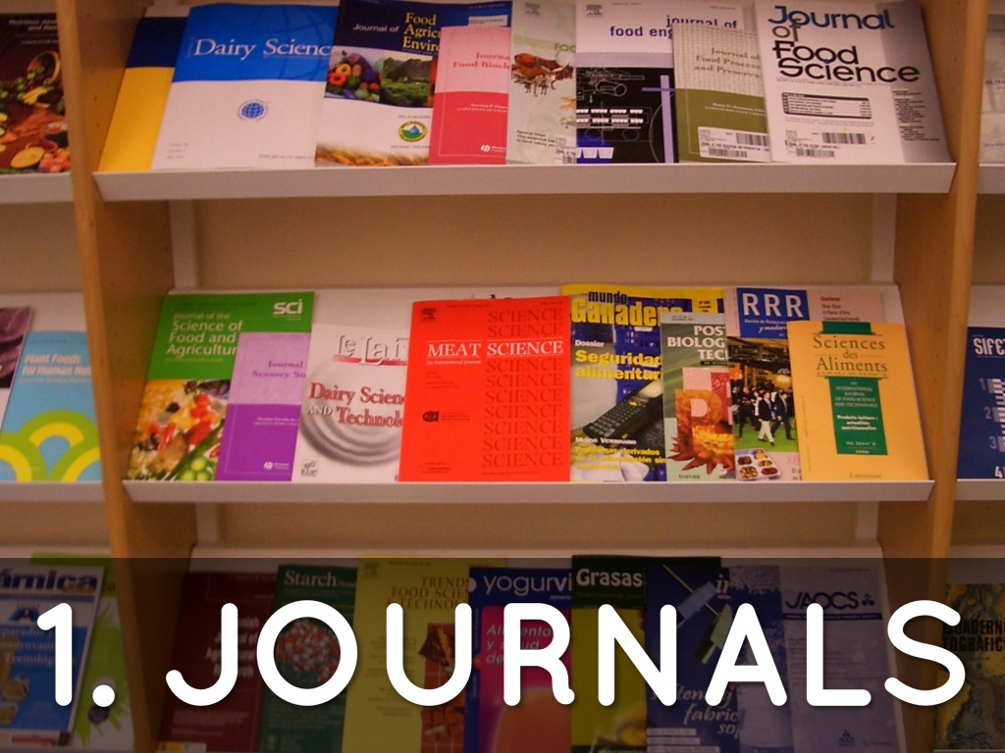

Slide 38


Slide 39
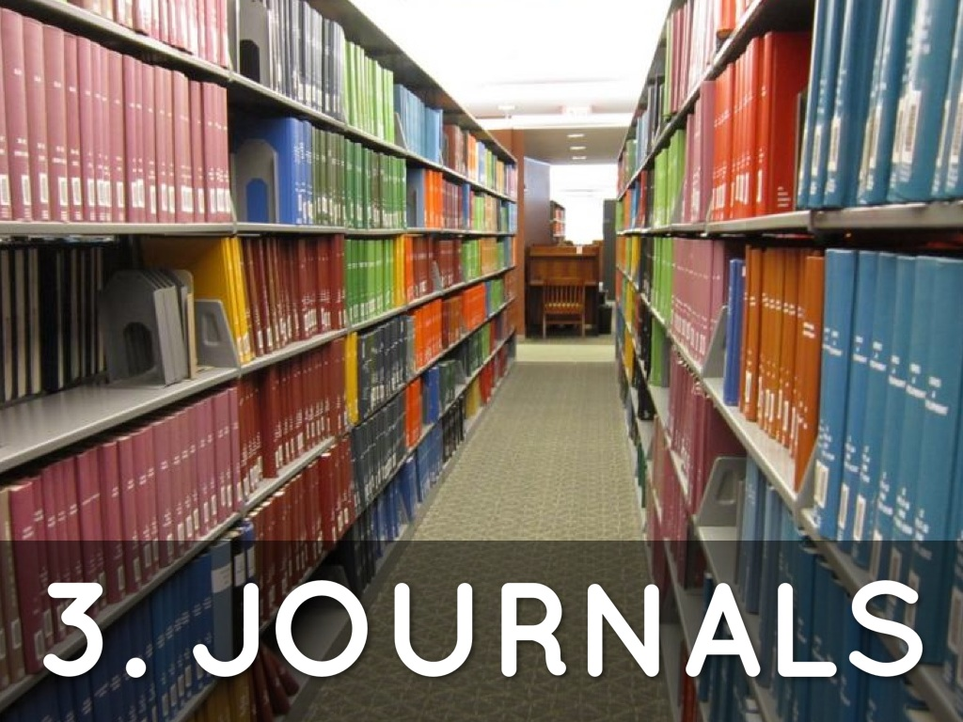

Slide 40


Slide 41
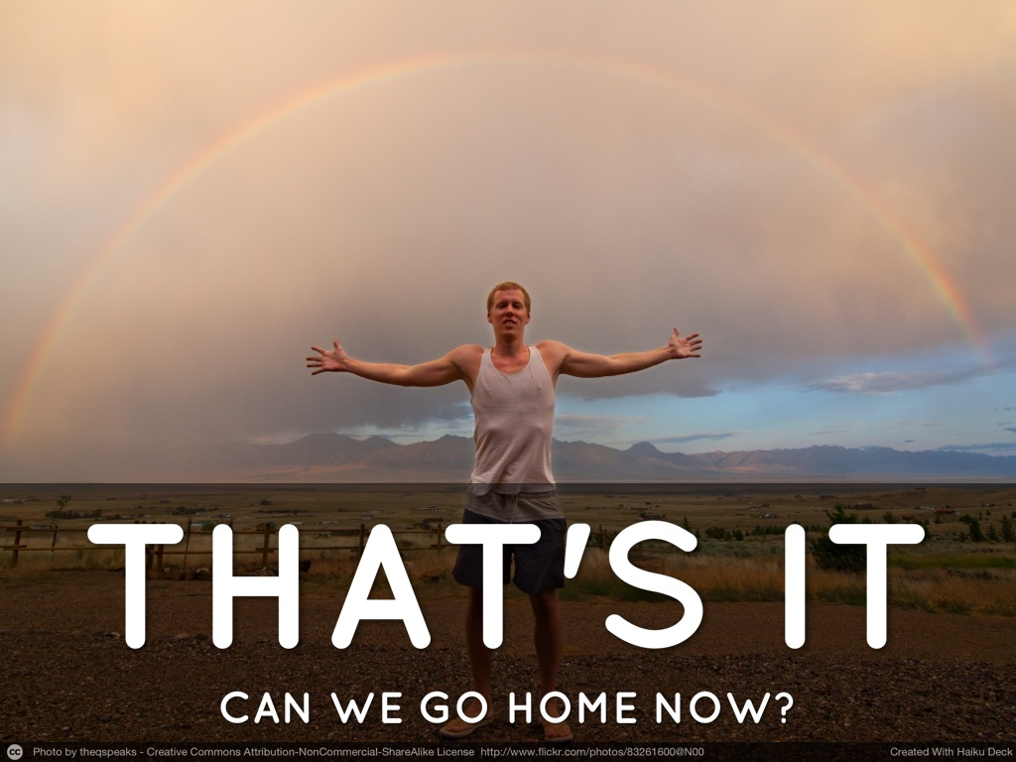

Slide 42
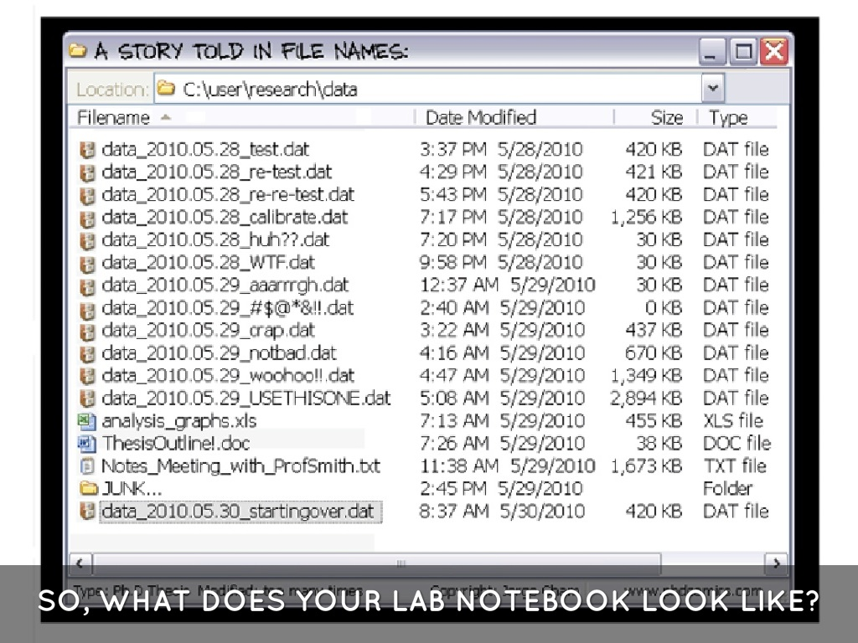

Slide 43
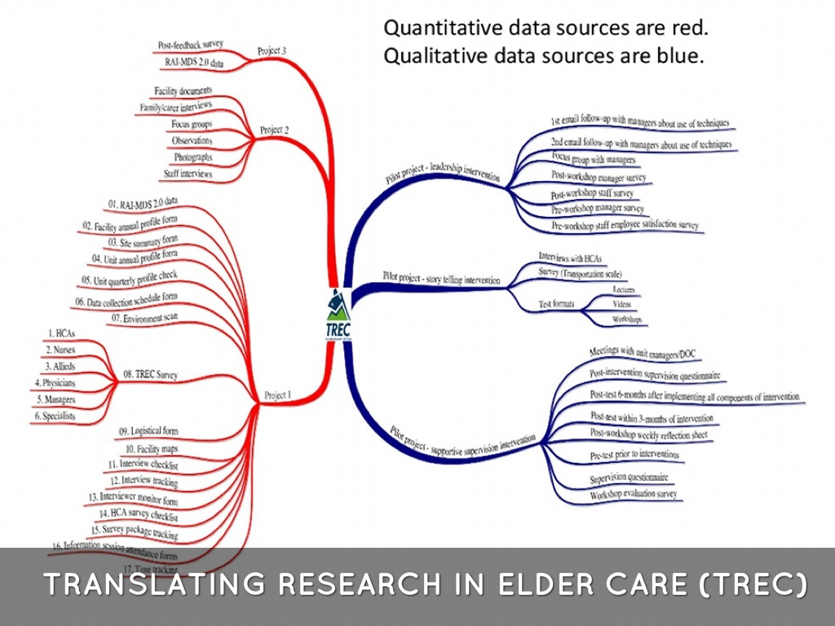

Slide 44
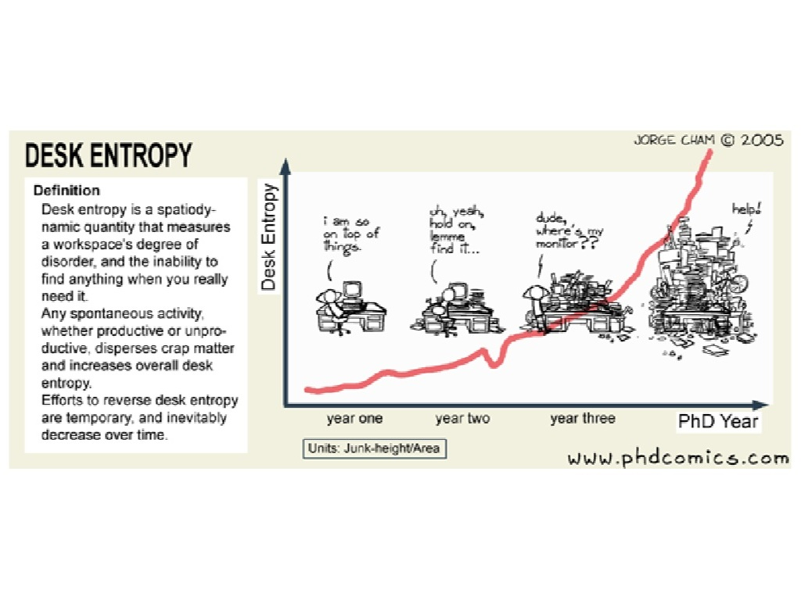

Slide 45
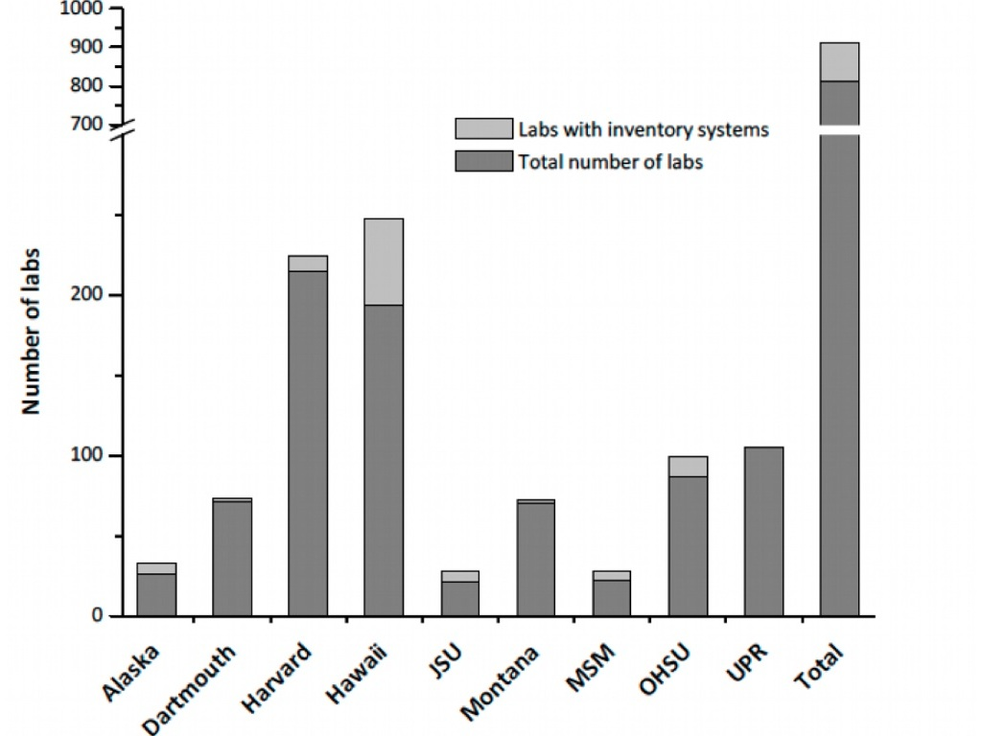

Slide 46
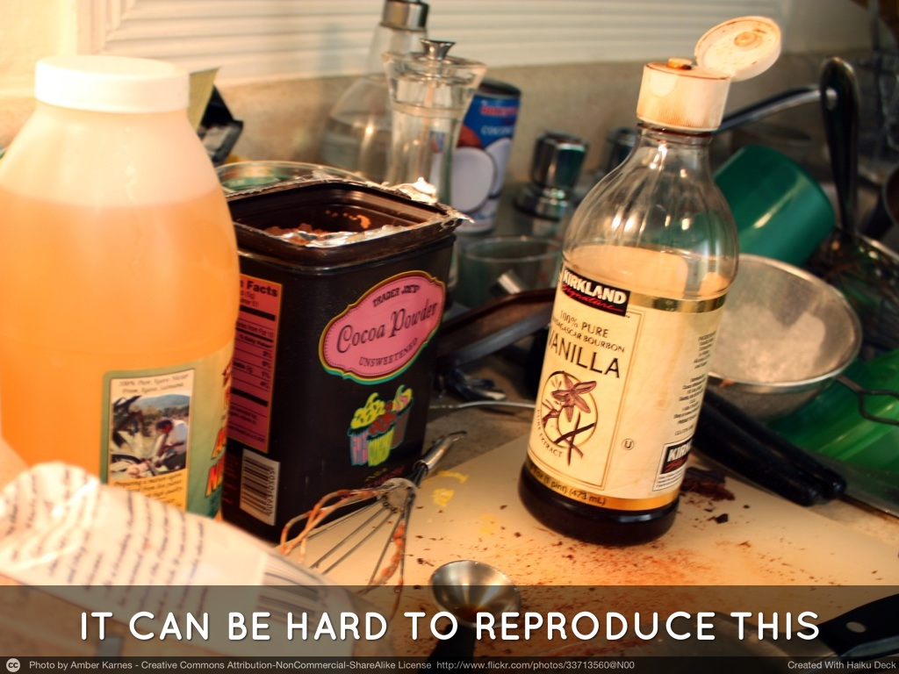

Slide 47
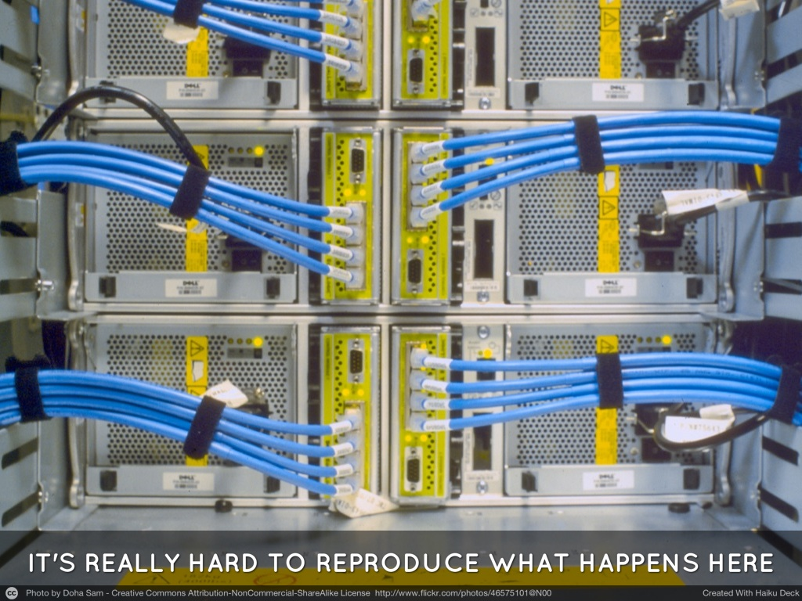

Slide 48
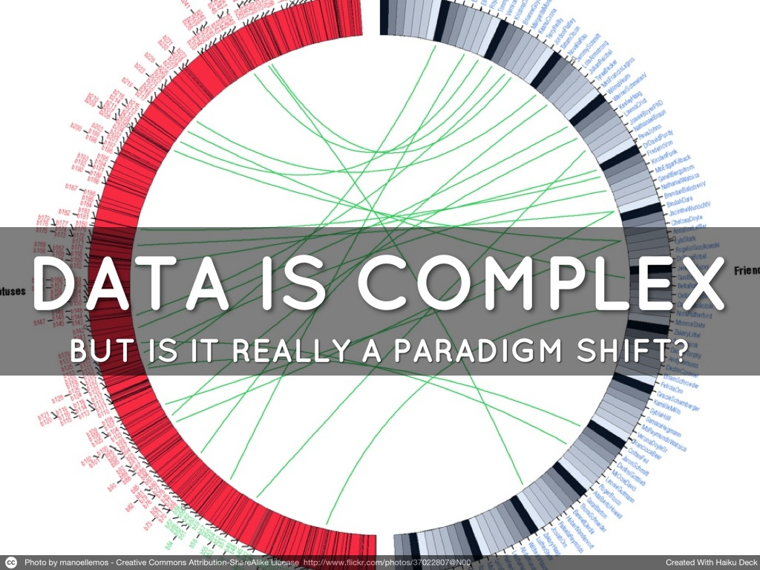

Slide 49
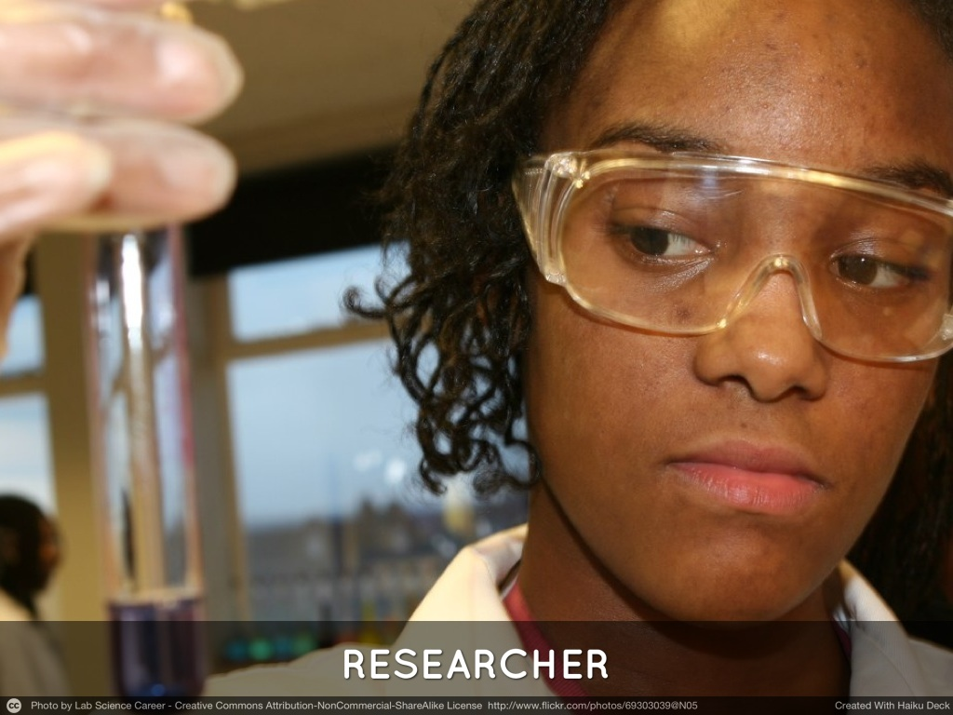

Slide 50
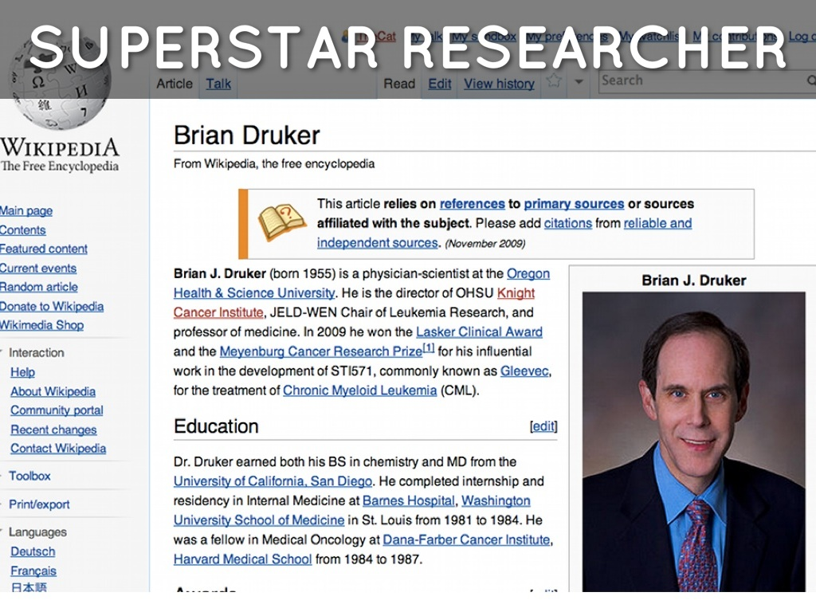

Slide 51
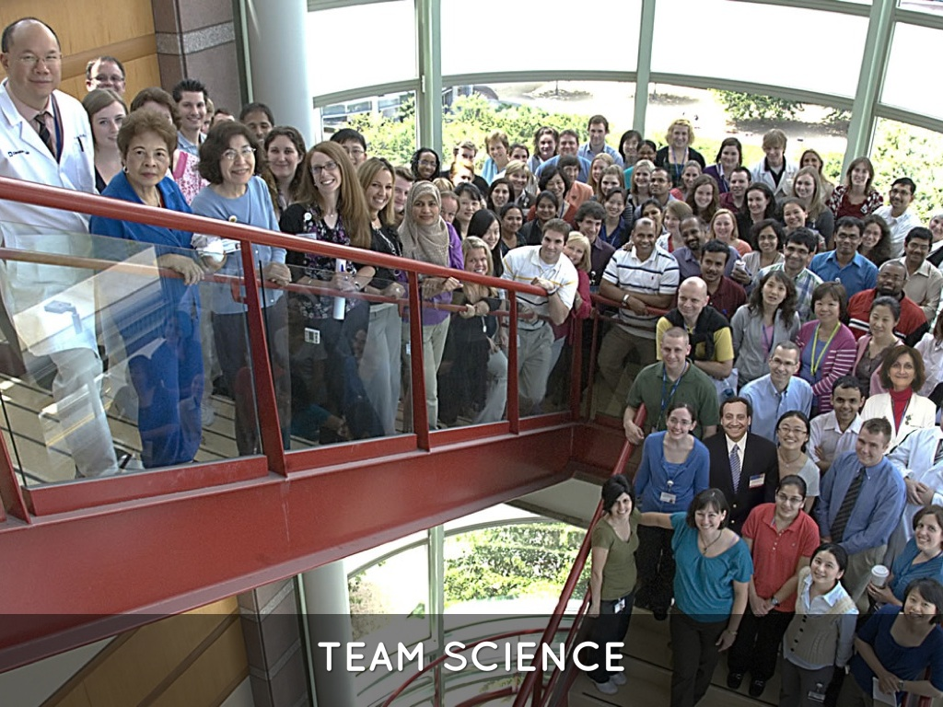

Slide 52
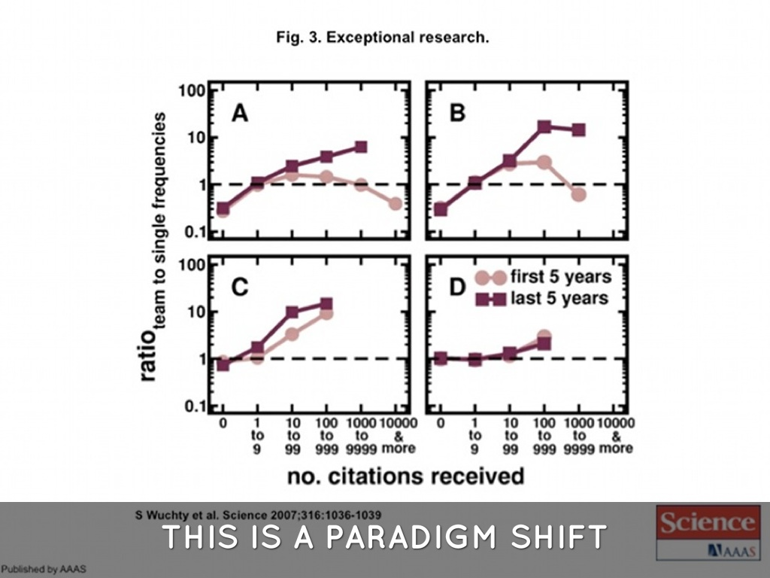

Slide 53
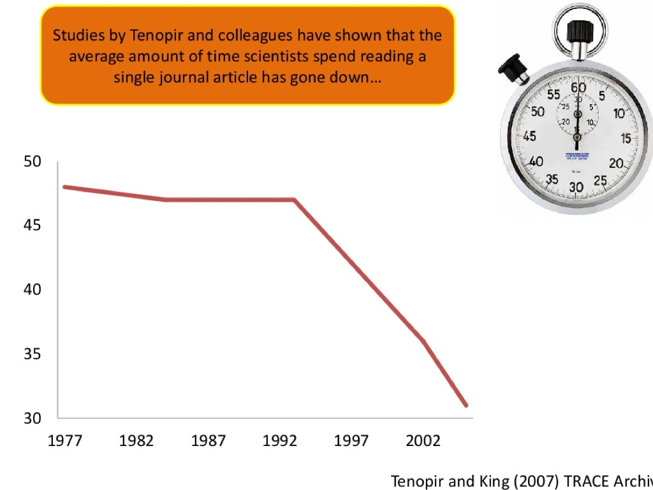

Slide 54
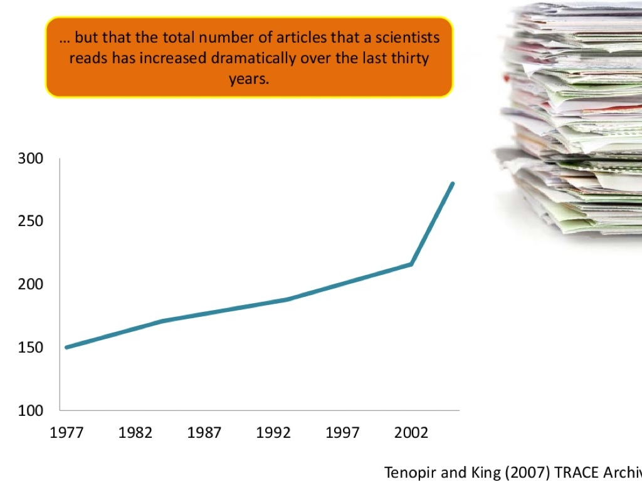

Slide 55
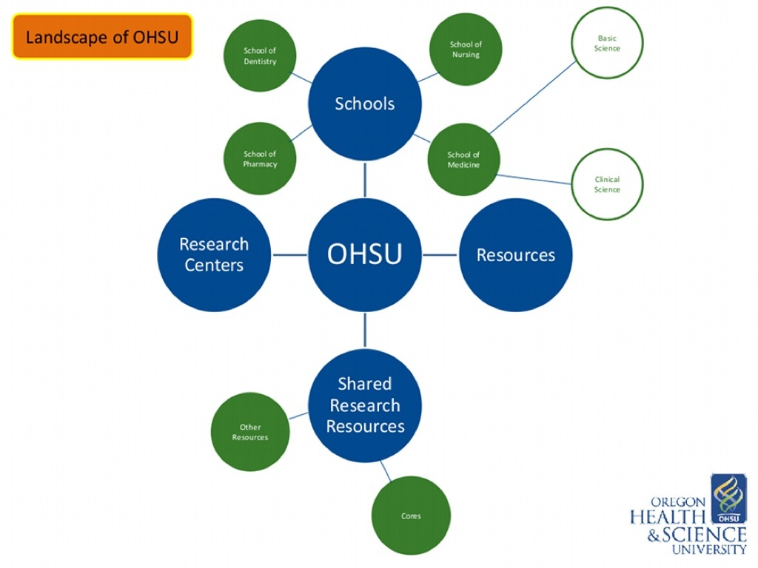

Slide 56
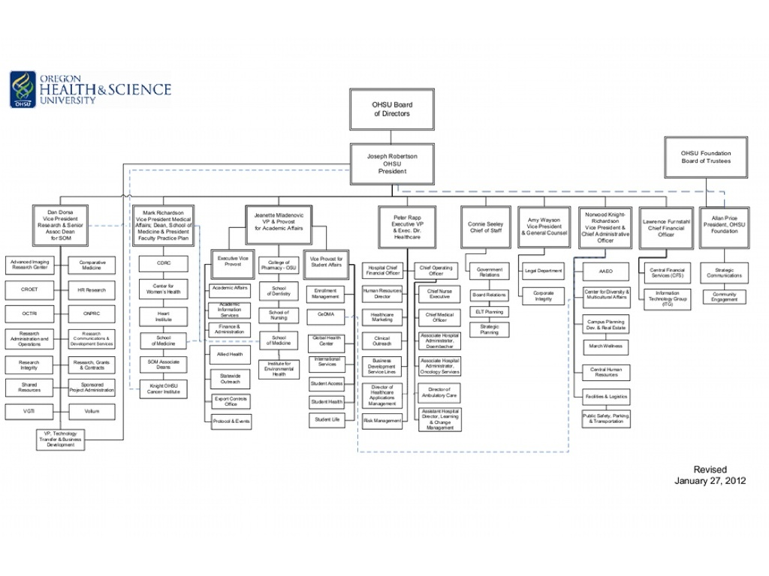

Slide 57
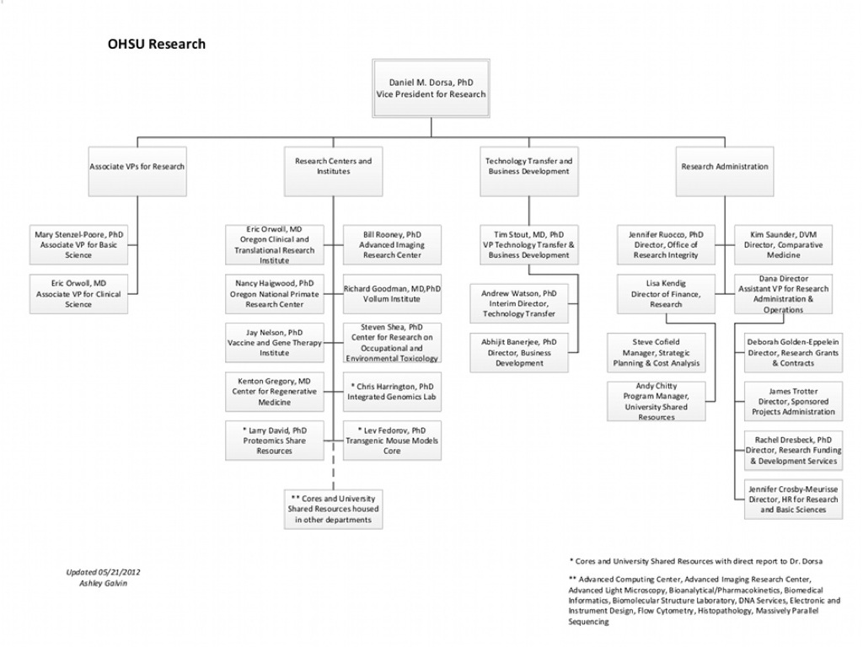

Slide 58
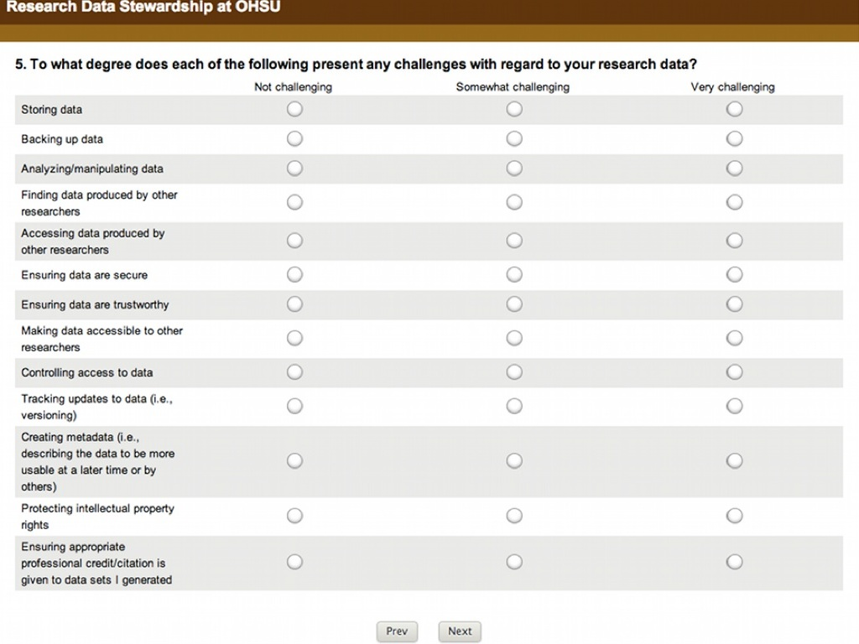

Slide 59
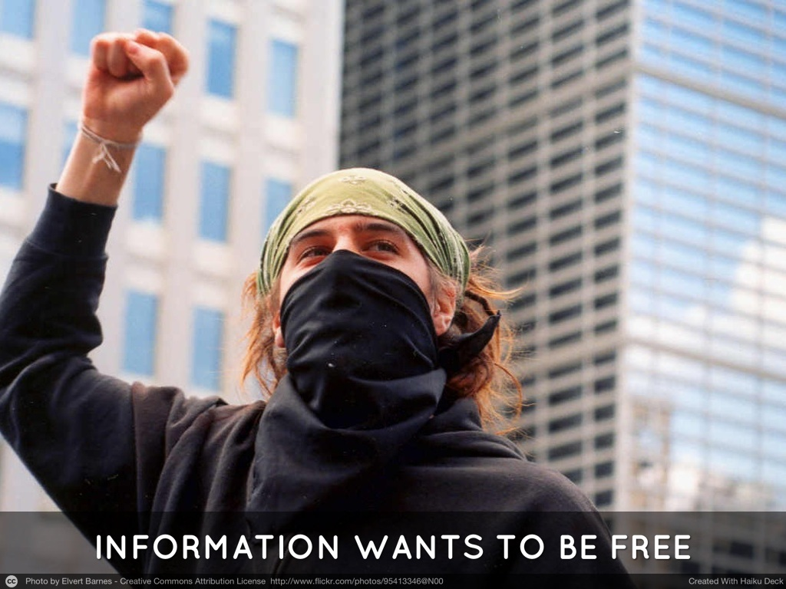

Slide 60
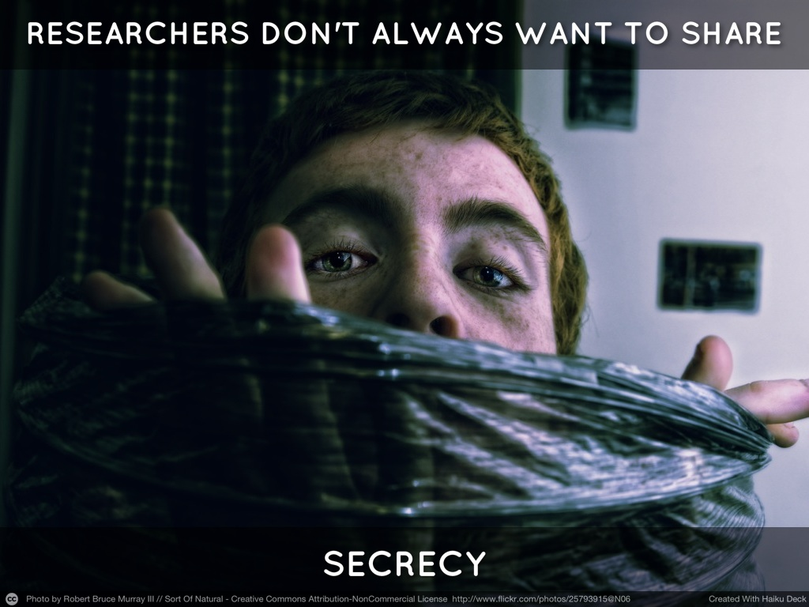

Slide 61
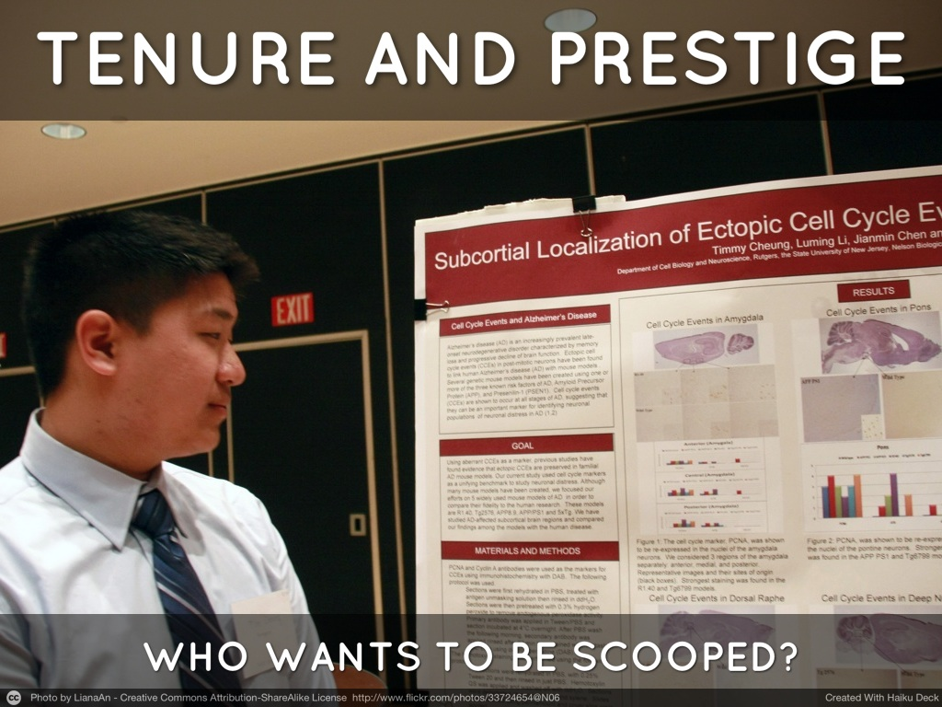

Slide 62
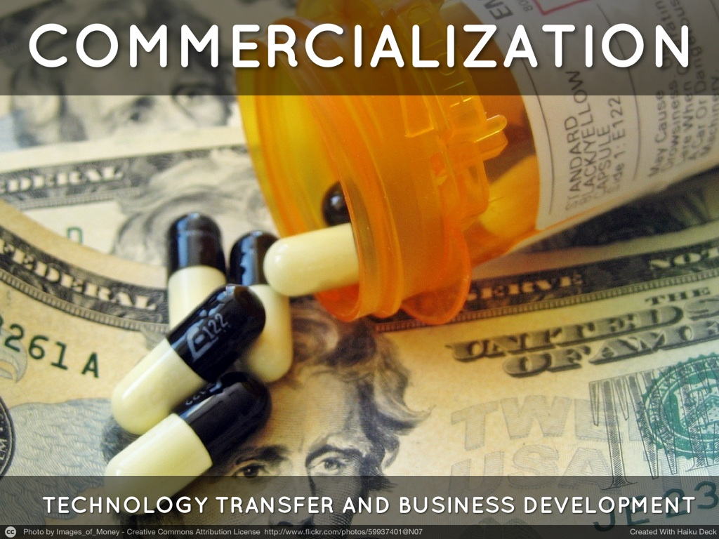

Slide 63
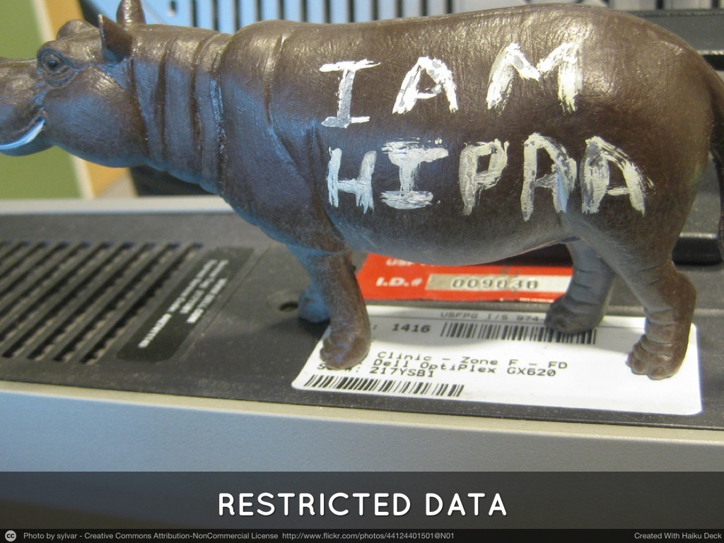

Slide 64
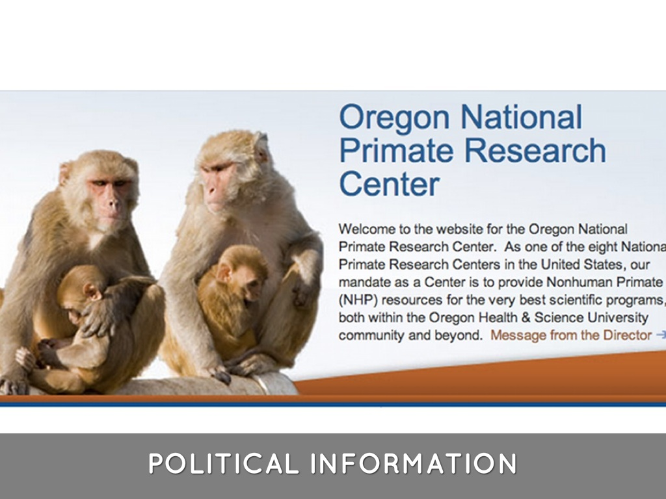

Slide 65
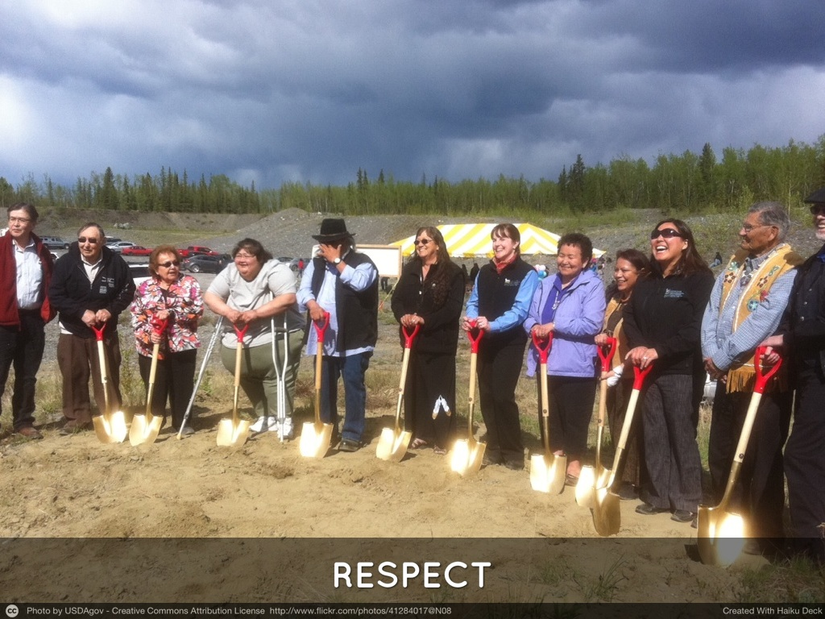

Slide 66
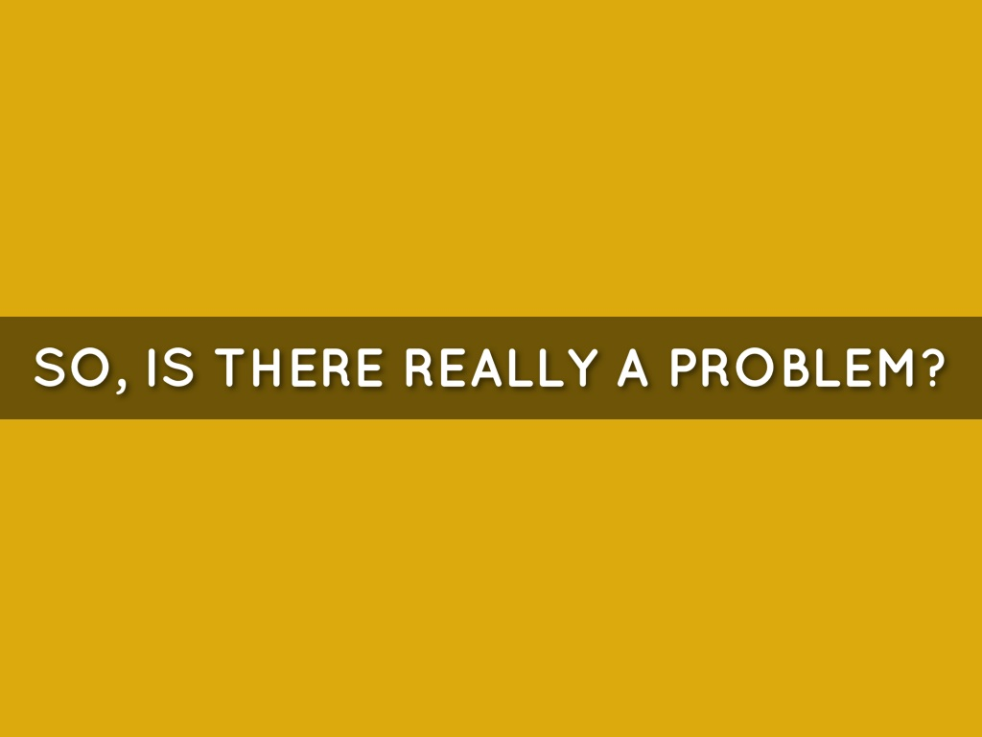

Slide 67
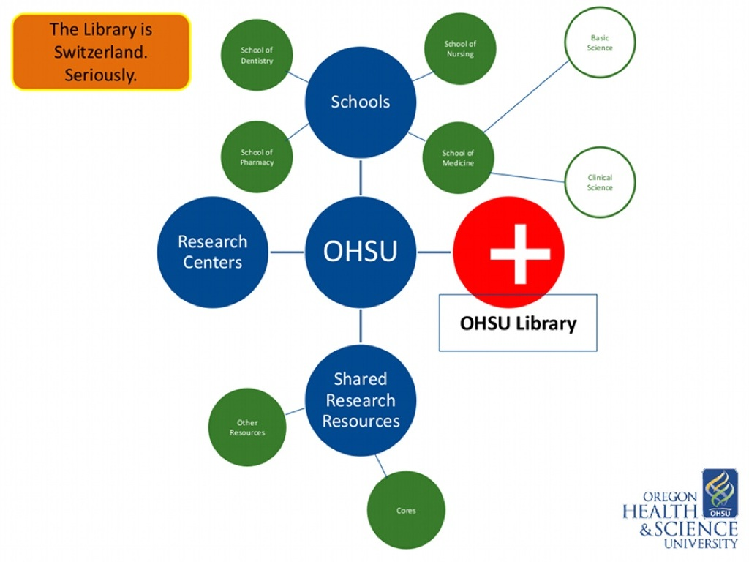

Slide 68
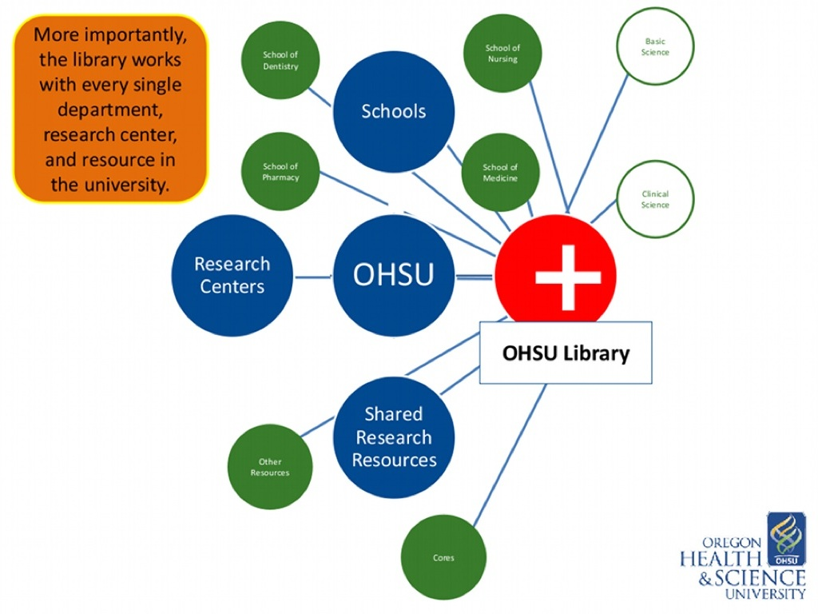

Slide 69


Slide 70
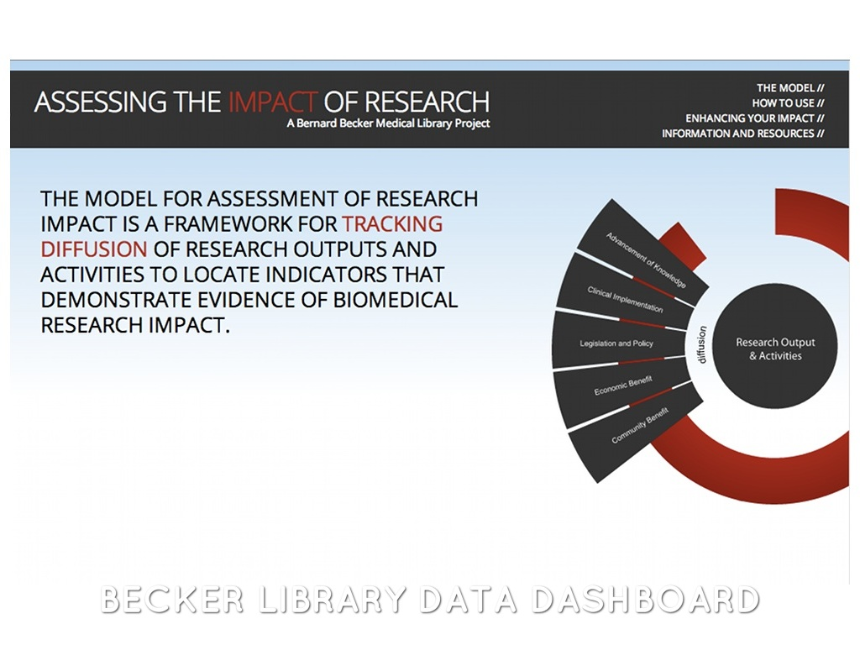

Slide 71
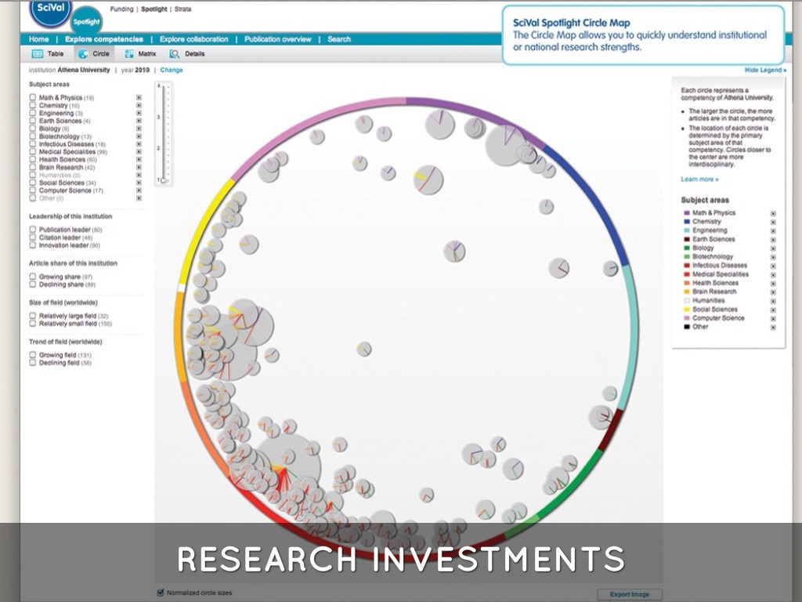

Slide 72
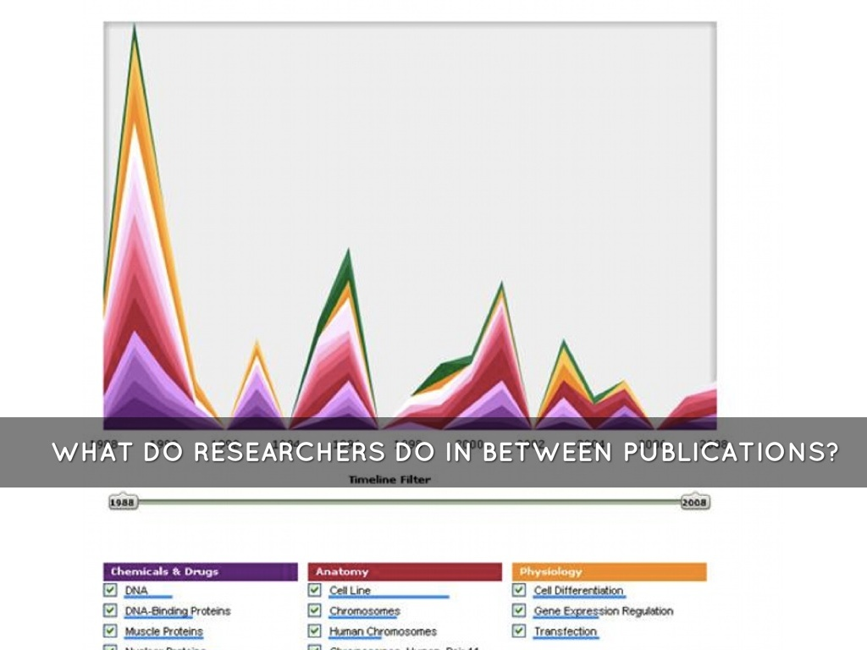

Slide 73
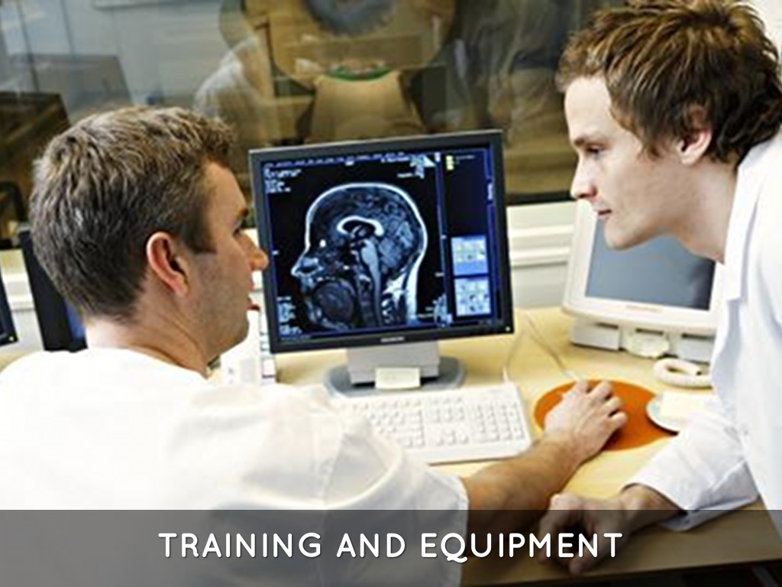

Slide 74
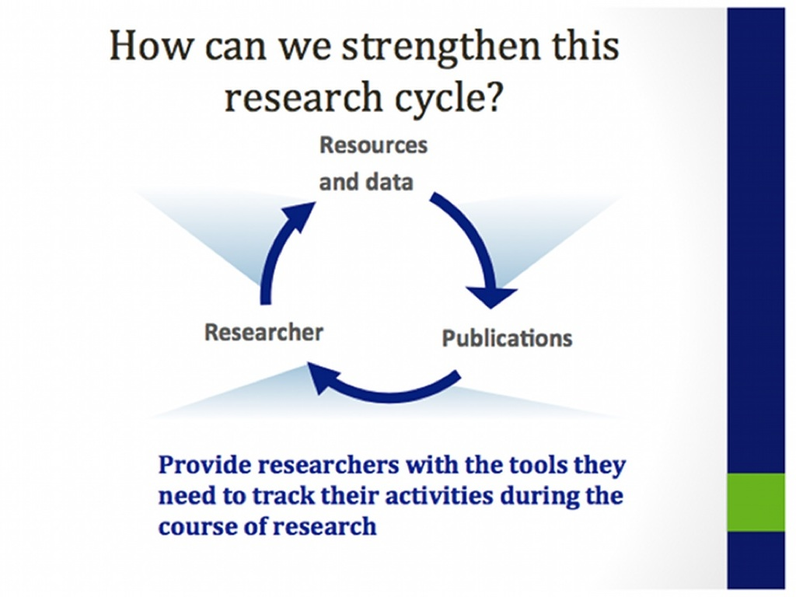

Slide 75
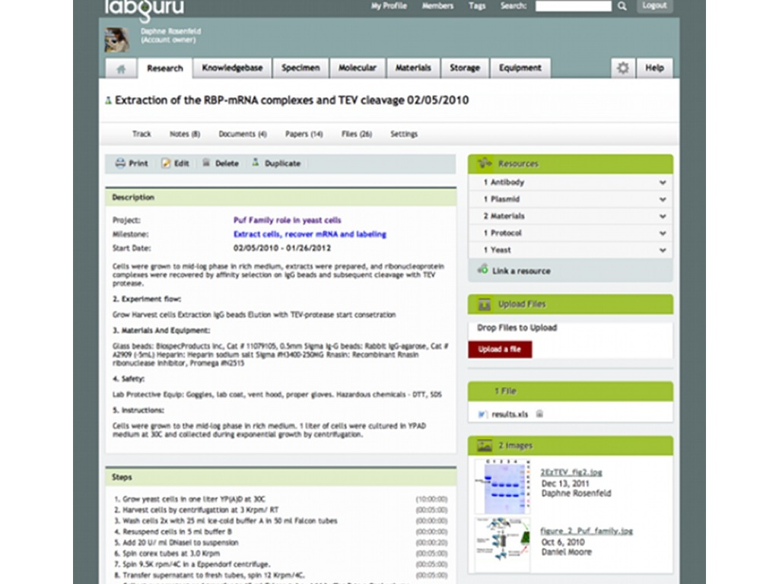

Slide 76
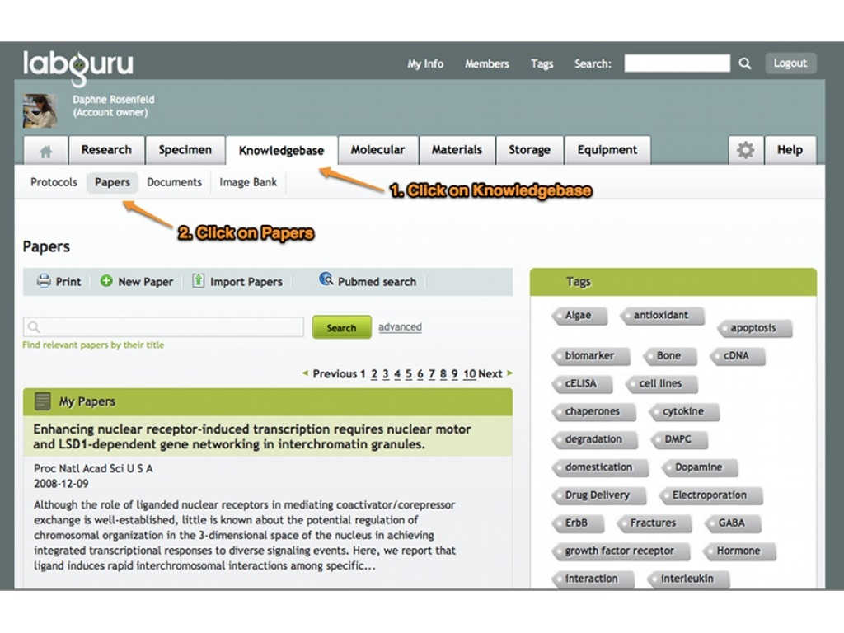

Slide 77
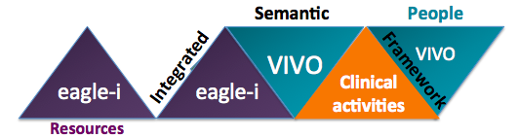

OHSU Library Ontology Development Group
CTAR and UDP

Slide 78
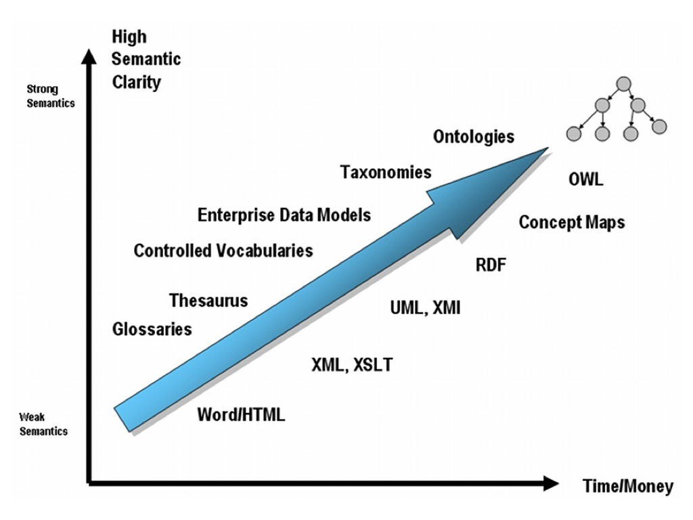

Slide 79

Using external vocabularies together

Slide 80


Slide 81


Slide 82


Slide 83


Slide 84


Slide 85


Slide 86
New Roles
Analysis and enhancement of user experiences
Support for social media
Support for systematic reviews
Clinical informationist
Help for faculty or staff with authorship issues
Implementation of researcher profiling and collaboration tools
Data management
Translational research
Crum JA, Cooper ID, JMLA October 2013

Slide 87


Slide 88


Slide 89


Slide 90
Credits
OHSU Library Ontology Development Group: http://www.ohsu.edu/library/ontology
Jackie Wirz, OHSU Library Biomedical Information Specialist
Becker Library, Washington University
Crum and Cooper, JMLA, October 2013
Tenopir and King, 2007
PhD Comics

Slide 91
Questions?
Chris Shaffer, MS, AHIP University Librarian and Associate Professor Oregon Health & Science University Library shafferc@ohsu.edu 503-367-4693 Skype: chris.shaffer http://www.ohsu.edu/library/

Slide 92

Seeking our niche: Understanding the needs of research personnel
to develop e-science services
Megan Sapp Nelson Associate Professor of Library Sciences, Purdue University Libraries

Slide 93

Objectives
Identify strengths that librarians have for introducing e-science topics for discussion with faculty
Characterize approaches to interacting with faculty
Identify tools that produce partnerships
.
.

Slide 94

Purdue University Libraries Our General Approach To Data Collaboration

Slide 95
D2C2
Distributed Data Curation Center
At Purdue, our approach to data management has been guided by that first word, distributed.
Implications
We don’t collect, we link.
We don’t gather, we connect.
We don’t set the workflows, we work with researchers to develop workflows.
(We’ll discuss the caveats later on. )

Slide 96
Staring down the barrel of e-science
A Case Study
The researcher with the traffic data

Slide 97
Stop the insanity! - The librarian - The researcher

Slide 98
Stop the insanity!
- The librarian
What is every single intimidating reason that you can come up with for being scared of e-science?

Slide 99

Stop the insanity!
- The librarian
What is every single intimidating reason that you can come up with for being scared of e-science?

Slide 100

Stop the insanity!
- The researcher
Your professors are facing:
More and more tools to collect data
A proliferation of data storage options with constantly dropping prices
Graduate students whose conception of project life is generally weeks, not years or decades
Few published best practices
No standards or too many standards, depending on the discipline
What do I bring to the table as a liaison that this professor does not have?

Slide 101
Stop the insanity!
A librarian’s strengths
What do we bring to the table?
Holistic information worldview
Role of both humans and technology
Expertise in helping others identify their information needs via interview
The reference interview
Experience in primarily teaching ‘professional’ skills
Information literacy
Practical, foundational skills not tied to a single discipline
Interdisciplinary role
Experience embedding in a given situation

Slide 102

Stop the insanity!
A case study
The researcher working in Uganda

Slide 103
How do you eat an elephant?

Slide 104
How do you eat an elephant?
Getting started
Professional development:
Unscientific observation: Read 10 articles on data curation. You’ve read more than 50% of the researchers you’ll contact.
Hint: Get cozy with JISC’s website.
Data Education Working Group
Environmental Scan:
Metadata standards for your liaison disciplines
Repositories for your liaison discipline http://databib.org/
Academic articles on data management written by those in the discipline
Available resources:
Your institution as a whole
Your library
You

Slide 105
Who are the people in your neighborhood?

Slide 106
Who are the people in your
NEIGHBORHOOD?
How are we going to know what researchers need?
Data Curation Profiles Project http://datacurationprofiles.org/
Data Information Literacy Project http://datainfolit.org
Data Management Plans https://dmp.cdlib.org/
Case Study
The researcher who saw the gaps

Slide 107
Making an offer they can’t refuse

Slide 108
Making an offer they can’t refuse
Data management is similar for all projects in the lifecycle.
Data management is unique to each research project in the details.
The value proposition for each researcher/research group for implementing data management is specific to the situation that they are in.
Data management has some similarities across disciplines.
Individual disciplines can have major impact on data management practices.

Slide 109
Making an offer they can’t refuse
Proposing a collaboration
Gap analysis – Where does the researcher want to be in data management? Where are they now? How does library science present opportunities to fill the gap?
Data Curation Profiles, Data Information Literacy interviews
Value proposition – What does the researcher most value? Immediate success of a grant, fix a specific problem?
Conversation
Resource availability
Environmental scan
Based on these three things, what are one or two solutions, large or small, that you can propose?

Slide 110
The caveat to ‘distributed’
A case study
When the researchers asked for centralized data management

Slide 111
CONTRIBUTORS PROJECTS GRANTS
In order of appearance…

Slide 112
Purdue affiliated projects mentioned in this presentation
Distributed Data Curation Center (d2c2.lib.purdue.edu)– Jacob Carlson, D. Scott Brandt, Michael Witt et al.
Graduate School of Library and Information Sciences- University of Illinois
Data Curation Profiles (datacurationprofiles.org) – IMLS funded
Databib – Michael Witt, Editor-in-Chief (databib.org) – IMLS funded
Data Information Literacy – Jacob Carlson, Megan Sapp Nelson, Michael Fosmire, Marianne Stowell Bracke et al. (datainfolit.org) – IMLS funded
Purdue University Research Repository – Michael Witt, Courtney Matthews (purr.purdue.edu)

Slide 113
Any questions?

Slide 114
Megan Sapp Nelson
msn@purdue.edu

Slide 115
Questions? All questions will be posted with presenter answers on the NISO website following the webinar: http://www.niso.org/news/events/2013/webinars/escience/
NISO Webinar:
Research Data Curation
Part 1: E-Science Librarianship
NISO Webinar • September 11, 2013

Slide 116
THANK YOU
Thank you for joining us today. Please take a moment to fill out the brief online survey.
We look forward to hearing from you!

